Slide 1
Algorithm Analysis and Design Divide and Conquer strategy (Maximum Sub-array Problem)
Lecture -15

Slide 2
Overview
• Learn the technique of “divide and conquer”
in the context of the maximum sub-array with
analysis.

Slide 3
The Maximum subarray Problem (A Divide and Conquer Approach)
Divide the problem into a number of sub problems.
Conquer the sub problems by solving them recursively.
Base case: If the sub problems are small enough, just solve them by brute force.
Combine the sub problem solutions to give a solution to the original problem.

Slide 4
The Maximum subarray problem
Problem: In a share market you can buy a unit of stock, only one time, then sell it at a later date
Buy/sell at end of day
Strategy: buy low, sell high
The lowest price may appear after the highest price
Assume you know future prices
Objective: Can you maximize profit by buying at lowest price and selling at highest price?

Slide 5
The Maximum subarray problem
Example 1:
Day | 0 | 1 | 2 | 3 | 4
Price | 10 | 11 | 7 | 10 | 6
Concept: Buy lowest sell highest
Objective : Maximize the profit

Slide 6
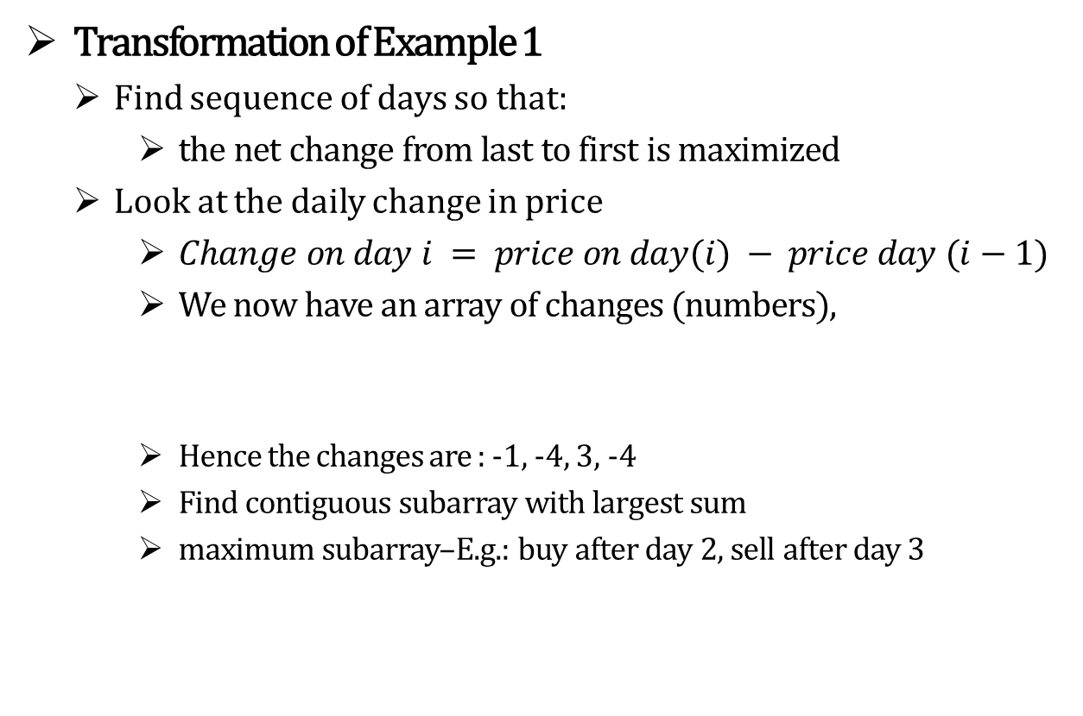
The Maximum subarray problem
Transformation of Example 1
Find sequence of days so that:
the net change from last to first is maximized
Look at the daily change in price
$Change on day i = price on day(i) − price day (i−1)$
We now have an array of changes (numbers),
Hence the changes are : -1, -4, 3, -4
Find contiguous subarray with largest sum
maximum subarray–E.g.: buy after day 2, sell after day 3
Day | 0 | 1 | 2 | 3 | 4
Price | 10 | 11 | 7 | 10 | 6
Changes |  | 1 | -4 | 3 | -4

Slide 7
The Maximum subarray problem
Example 2:
Day | 0 | 1 | 2 | 3 | 4 | 5 | 6 | 7 | 8 | 9 | 10 | 11 | 12 | 13 | 14 | 15 | 16
Price | 100 | 113 | 110 | 85 | 105 | 102 | 86 | 63 | 81 | 101 | 94 | 106 | 101 | 79 | 94 | 90 | 97
Concept: Buy lowest sell highest Objective : Maximize the profit

Slide 8
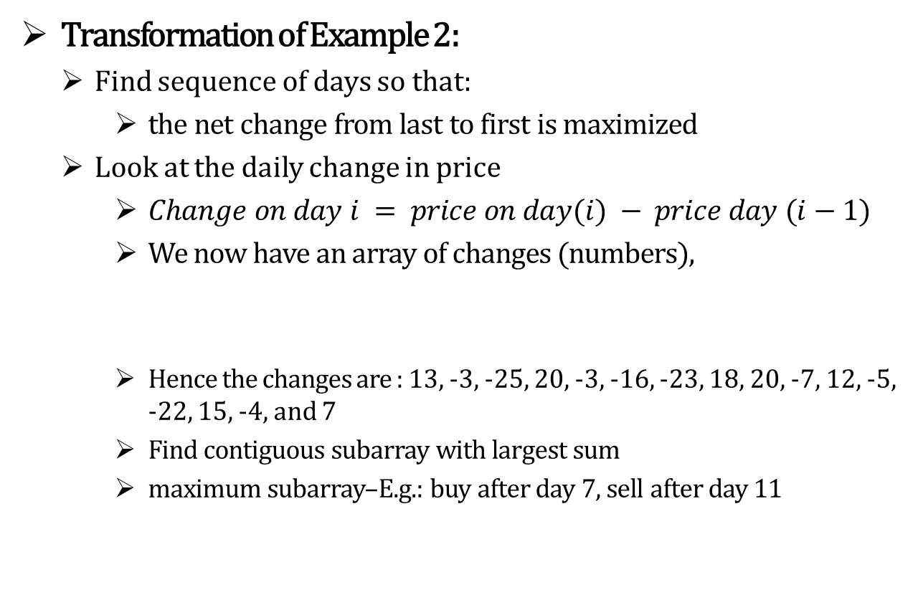
The Maximum subarray problem
Transformation of Example 2:
Find sequence of days so that:
the net change from last to first is maximized
Look at the daily change in price
$Change on day i = price on day(i) − price day (i−1)$
We now have an array of changes (numbers),
Hence the changes are : 13, -3, -25, 20, -3, -16, -23, 18, 20, -7, 12, -5, -22, 15, -4, and 7
Find contiguous subarray with largest sum
maximum subarray–E.g.: buy after day 7, sell after day 11
Day | 0 | 1 | 2 | 3 | 4 | 5 | 6 | 7 | 8 | 9 | 10 | 11 | 12 | 13 | 14 | 15 | 16
Price | 100 | 113 | 110 | 85 | 105 | 102 | 86 | 63 | 81 | 101 | 94 | 106 | 101 | 79 | 94 | 90 | 97
Changes |  | 13 | -3 | -25 | 20 | -3 | -16 | -23 | 18 | 20 | -7 | 12 | -5 | -22 | 15 | -4 | 7

Slide 9
The Maximum subarray problem
Brute force Approach
How many buy/sell pairs are possible over ‘n’ days?
(i.e. search every possible pair of buy and sell dates in which the buy date precedes the sell date)
Evaluate each pair and keep track of maximum.

Slide 10
The Maximum subarray problem
Brute force Approach
Day | 0 | 1 | 2 | 3 | 4 | 5 | 6 | 7 | 8 | 9 | 10 | 11 | 12 | 13 | 14 | 15 | 16
Price | 100 | 113 | 110 | 85 | 105 | 102 | 86 | 63 | 81 | 101 | 94 | 106 | 101 | 79 | 94 | 90 | 97
Changes(A) |  | 13 | -3 | -25 | 20 | -3 | -16 | -23 | 18 | 20 | -7 | 12 | -5 | -22 | 15 | -4 | 7
S[1,1] |  | 13
S[1,2] |  |  | 10
S[1,3] |  |  |  | -15
S[1,4] |  |  |  |  | 5
S[1,5] |  |  |  |  |  | 2
S[1,6] |  |  |  |  |  |  | -14
S[1,7] |  |  |  |  |  |  |  | -37
S[1,8] |  |  |  |  |  |  |  |  | -19
S[1,9] |  |  |  |  |  |  |  |  |  | 1
S[1,10] |  |  |  |  |  |  |  |  |  |  | -6
S[1,11] |  |  |  |  |  |  |  |  |  |  |  | 6
S[1,12] |  |  |  |  |  |  |  |  |  |  |  |  | 1
S[1,13] |  |  |  |  |  |  |  |  |  |  |  |  |  | -21
S[1,14] |  |  |  |  |  |  |  |  |  |  |  |  |  |  | -6
S[1,15] |  |  |  |  |  |  |  |  |  |  |  |  |  |  |  | -10
S[1,16] |  |  |  |  |  |  |  |  |  |  |  |  |  |  |  |  | -3

Slide 11
The Maximum subarray problem
Brute force Approach
A[1..16] |  | 13 | -3 | -25 | 20 | -3 | -16 | -23 | 18 | 20 | -7 | 12 | -5 | -22 | 15 | -4 | 7
 |  | SUB STRING ARRAY (i.e. S Array)
 |  | [1] | [2] | [3] | [4] | [5] | [6] | [7] | [8] | [9] | [10] | [11] | [12] | [13] | [14] | [15] | [16]
 | [1] | 13 | 10 | -15 | 5 | 2 | -14 | -37 | -19 | 1 | -6 | 6 | 1 | -21 | -6 | -10 | -3
 | [2] |  | -3 | -28 | -8 | -11 | -27 | -50 | -32 | -12 | -19 | -7 | -12 | -34 | -19 | -23 | -16
 | [3] |  |  | -25 | -5 | -8 | -24 | -47 | -29 | -9 | -16 | -4 | -9 | -31 | -16 | -20 | -13
 | [4] |  |  |  | 20 | 17 | 1 | -22 | -4 | 16 | 9 | 21 | 16 | -6 | 9 | 5 | 12
 | [5] |  |  |  |  | -3 | -19 | -42 | -24 | -4 | -11 | 1 | -4 | -26 | -11 | -15 | -8
 | [6] |  |  |  |  |  | -16 | -39 | -21 | -1 | -8 | 4 | -1 | -23 | -8 | -12 | -5
 | [7] |  |  |  |  |  |  | -23 | -5 | 15 | 8 | 20 | 15 | -7 | 8 | 4 | 11
 | [8] |  |  |  |  |  |  |  | 18 | 38 | 31 | 43 | 38 | 16 | 31 | 27 | 34
 | [9] |  |  |  |  |  |  |  |  | 20 | 13 | 25 | 20 | -2 | 13 | 9 | 16
 | [10] |  |  |  |  |  |  |  |  |  | -7 | 5 | 0 | -22 | -7 | -11 | -4
 | [11] |  |  |  |  |  |  |  |  |  |  | 12 | 7 | -15 | 0 | -4 | 3
 | [12] |  |  |  |  |  |  |  |  |  |  |  | -5 | -27 | -12 | -16 | -9
 | [13] |  |  |  |  |  |  |  |  |  |  |  |  | -22 | -7 | -11 | -4
 | [14] |  |  |  |  |  |  |  |  |  |  |  |  |  | 15 | 11 | 18
 | [15] |  |  |  |  |  |  |  |  |  |  |  |  |  |  | -4 | 3
 | [16] |  |  |  |  |  |  |  |  |  |  |  |  |  |  |  | 7
Hence, maximum subarray–E.g.: buy after day 7, sell after day 11

Slide 12

The Maximum subarray problem
Brute force Approach
The total number of pairs are $\left(\begin{matrix}n \\ 2\end{matrix}\right)$. Hence the complexity is $Θ(n^{2})$
Can we do better?

Slide 13
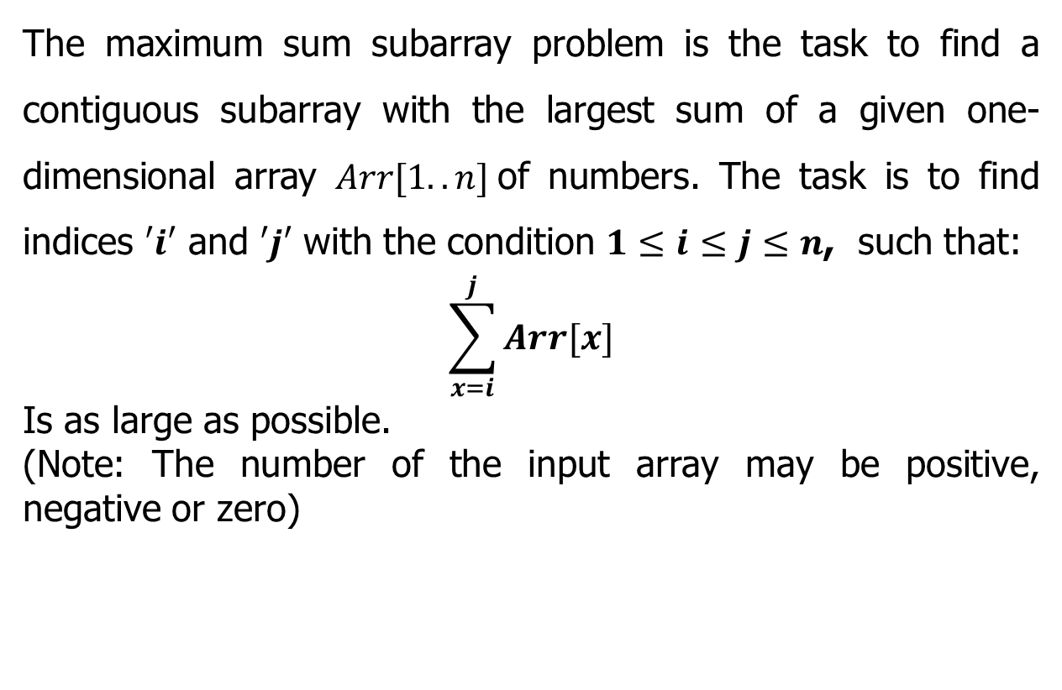
The Maximum subarray problem
The maximum sum subarray problem is the task to find a contiguous subarray with the largest sum of a given one-dimensional array $Arr[1..n]$of numbers. The task is to find indices $′i′$ and $′j′$ with the condition $1≤i≤j≤n$, such that:
$$\sum_{x=i}^{j}{Arr[x]}$$
Is as large as possible.
(Note: The number of the input array may be positive, negative or zero)

Slide 14
The Maximum sum subarray problem
Input: an array A[1..n] of n numbers
Assume that some of the numbers are negative, because this problem is trivial when all numbers are nonnegative
Output: a nonempty subarray A[i..j] having the largest sum
S[i, j] = A_{i} + A_{i+1} +... + A_{j}
Day | 0 | 1 | 2 | 3 | 4 | 5 | 6 | 7 | 8 | 9 | 10 | 11 | 12 | 13 | 14 | 15 | 16
Price | 100 | 113 | 110 | 85 | 105 | 102 | 86 | 63 | 81 | 101 | 94 | 106 | 101 | 79 | 94 | 90 | 97
Changes |  | 13 | -3 | -25 | 20 | -3 | -16 | -23 | 18 | 20 | -7 | 12 | -5 | -22 | 15 | -4 | 7
1 2 3 4 5 6 7 8 9 10 11 12 13 14 15 16
A
13 | -3 | -25 | 20 | -3 | -16 | -23 | 18 | 20 | -7 | 12 | -5 | -22 | 15 | -4 | 7
maximum subarray

Slide 15
The Maximum subarray problem
Divide and Conquer Approach
Subproblem: Find a maximum subarray of A[low .. high]
In initial call, low =1 and high= n.
Divide: the subarray into two subarrays of as equal size as possible. Find the midpoint mid of the subarrays, and consider the subarrays A[low ..mid] and A[mid+1 .. high] .
Conquer: by finding the maximum subarrays of A[low .. mid] and A[mid+1..high] .
Combine: by finding a maximum subarray that crosses the midpoint, and using the best solution out of the three (the subarray crossing the midpoint and the two solutions found in the conquer step).

Slide 16
The Maximum subarray problem
Divide and Conquer Approach
Possible locations of a maximum subarray A[i..j] of A[low..high], where mid = ⎣(low+high)/2⎦
entirely in A[low..mid] (low ≤ i ≤ j ≤ mid)
entirely in A[mid+1..high] (mid < i ≤ j ≤ high)
crossing the midpoint (low ≤ i ≤ mid < j ≤ high)

Slide 17
The Maximum subarray problem
Divide and Conquer Approach
crosses the midpoint
low mid high
mid +1
entirely in A[low..mid]
entirely in A[mid+1..high]
Fig (a): Possible locations of subarrays of A[low..high]
A[mid+1..j]
i
low mid high
mid +1
j
A[i..mid]
Fig (b): A[i..j] comprises two subarrays A[i..mid] and A[mid+1..j]

Slide 18
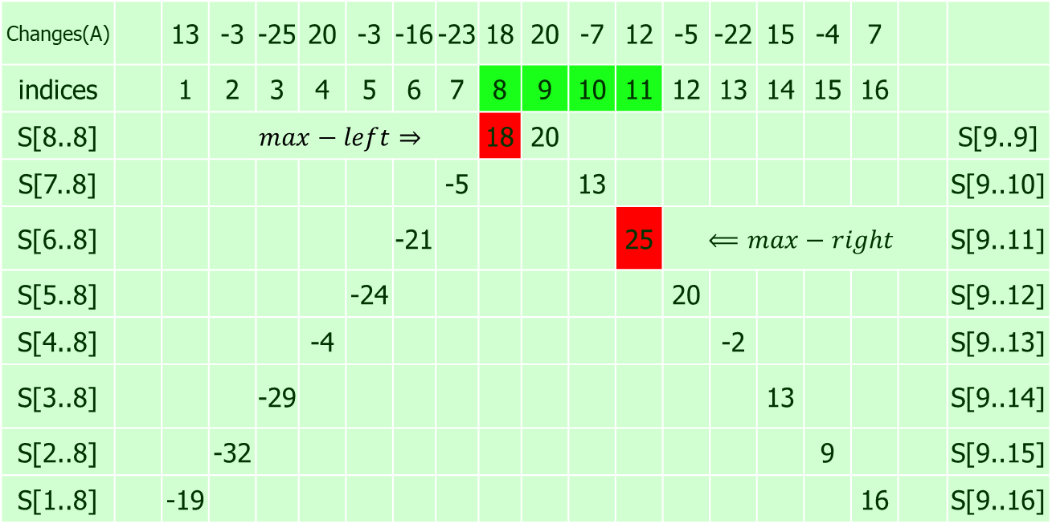
The Maximum subarray problem
Changes(A) |  | 13 | -3 | -25 | 20 | -3 | -16 | -23 | 18 | 20 | -7 | 12 | -5 | -22 | 15 | -4 | 7
indices |  | 1 | 2 | 3 | 4 | 5 | 6 | 7 | 8 | 9 | 10 | 11 | 12 | 13 | 14 | 15 | 16
S[8..8] |  |  | $$max−left⇒$$ |  |  |  |  |  | 18 | 20 |  |  |  |  |  |  |  |  | S[9..9]
S[7..8] |  |  |  |  |  |  |  | -5 |  |  | 13 |  |  |  |  |  |  |  | S[9..10]
S[6..8] |  |  |  |  |  |  | -21 |  |  |  |  | 25 | $$⟸max−right$$ |  |  |  |  |  | S[9..11]
S[5..8] |  |  |  |  |  | -24 |  |  |  |  |  |  | 20 |  |  |  |  |  | S[9..12]
S[4..8] |  |  |  |  | -4 |  |  |  |  |  |  |  |  | -2 |  |  |  |  | S[9..13]
S[3..8] |  |  |  | -29 |  |  |  |  |  |  |  |  |  |  | 13 |  |  |  | S[9..14]
S[2..8] |  |  | -32 |  |  |  |  |  |  |  |  |  |  |  |  | 9 |  |  | S[9..15]
S[1..8] |  | -19 |  |  |  |  |  |  |  |  |  |  |  |  |  |  | 16 |  | S[9..16]
$$⟹maximum subarray crossing mid is S[8..11] = 18+25=43$$

Slide 19
The Maximum subarray problem

Slide 20
The Maximum subarray problem

Slide 21
The Maximum subarray problem
Initial call: FIND-MAXIMUM-SUBARRAY(A,1,n)
Divide by computing mid.
Conquer by the two recursive calls to FIND-MAXIMUM-SUBARRAY.
Combine by calling FIND-MAX-CROSSING-SUBARRAY and then determining
which of the three results gives the maximum sum.
Base case is when the subarray has only 1 element.

Slide 22
The Maximum subarray problem
Divide and Conquer Approach
13 | -3 | -25 | 20 | -3 | -16 | -23 | 18 | 20 | -7 | 12 | -5 | -22 | 15 | -4 | 7
1 | 2 | 3 | 4 | 5 | 6 | 7 | 8 | 9 | 10 | 11 | 12 | 13 | 14 | 15 | 16
Divide
13 | -3 | -25 | 20 | -3 | -16 | -23 | 18 | 20 | -7 | 12 | -5 | -22 | 15 | -4 | 7
1 | 2 | 3 | 4 | 5 | 6 | 7 | 8 | 9 | 10 | 11 | 12 | 13 | 14 | 15 | 16
Divide
13 | -3 | -25 | 20 | -3 | -16 | -23 | 18 | 20 | -7 | 12 | -5 | -22 | 15 | -4 | 7
1 | 2 | 3 | 4 | 5 | 6 | 7 | 8 | 9 | 10 | 11 | 12 | 13 | 14 | 15 | 16
Divide
13 | -3 | -25 | 20 | -3 | -16 | -23 | 18 | 20 | -7 | 12 | -5 | -22 | 15 | -4 | 7
1 | 2 | 3 | 4 | 5 | 6 | 7 | 8 | 9 | 10 | 11 | 12 | 13 | 14 | 15 | 16
Divide
13 | -3 | -25 | 20 | -3 | -16 | -23 | 18 | 20 | -7 | 12 | -5 | -22 | 15 | -4 | 7
1 | 2 | 3 | 4 | 5 | 6 | 7 | 8 | 9 | 10 | 11 | 12 | 13 | 14 | 15 | 16

Slide 23
The Maximum subarray problem
Divide and Conquer Approach
maximum subarray
13 | -3 | -25 | 20 | -3 | -16 | -23 | 18 | 20 | -7 | 12 | -5 | -22 | 15 | -4 | 7
1 | 2 | 3 | 4 | 5 | 6 | 7 | 8 | 9 | 10 | 11 | 12 | 13 | 14 | 15 | 16
LS=20
RS=25
Conquer
CS=43
13 | -3 | -25 | 20 | -3 | -16 | -23 | 18 | 20 | -7 | 12 | -5 | -22 | 15 | -4 | 7
1 | 2 | 3 | 4 | 5 | 6 | 7 | 8 | 9 | 10 | 11 | 12 | 13 | 14 | 15 | 16
LS=20
RS=18
LS=25
RS=18
Conquer
CS=17
CS=16
13 | -3 | -25 | 20 | -3 | -16 | -23 | 18 | 20 | -7 | 12 | -5 | -22 | 15 | -4 | 7
1 | 2 | 3 | 4 | 5 | 6 | 7 | 8 | 9 | 10 | 11 | 12 | 13 | 14 | 15 | 16
LS=13
RS=20
LS=-3
RS=18
LS=20
RS=12
LS=15
RS=7
Conquer
CS=5
CS=-21
CS=25
CS=18
13 | -3 | -25 | 20 | -3 | -16 | -23 | 18 | 20 | -7 | 12 | -5 | -22 | 15 | -4 | 7
1 | 2 | 3 | 4 | 5 | 6 | 7 | 8 | 9 | 10 | 11 | 12 | 13 | 14 | 15 | 16
LS=13
LS=-23
RS=18
LS=20
LS=12
RS=-5
LS=-22
LS=-4
RS=7
LS=-25
RS=-7
RS=15
RS=-3
RS=20
LS=-3
RS=-16
Conquer
CS=10
CS=-5
CS=-19
CS=-5
CS=13
CS=7
CS=-7
CS=3
13 | -3 | -25 | 20 | -3 | -16 | -23 | 18 | 20 | -7 | 12 | -5 | -22 | 15 | -4 | 7
1 | 2 | 3 | 4 | 5 | 6 | 7 | 8 | 9 | 10 | 11 | 12 | 13 | 14 | 15 | 16
[Note: Where LS (Left Sum), RS (Right Sum) and CS (Cross Sum)]

Slide 24
Analysing Maximum subarray problem

Slide 25
Analysing Maximum subarray problem

Slide 26
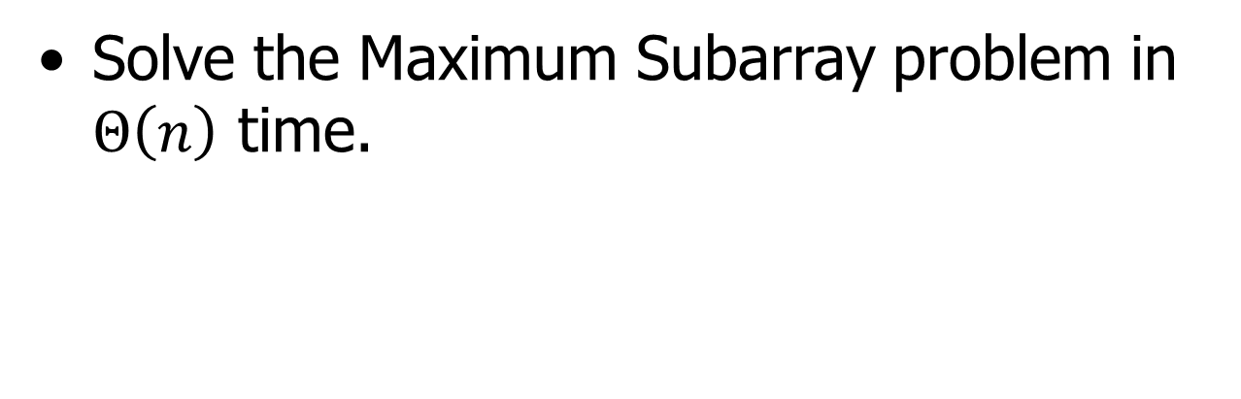
Home Assignment
Solve the Maximum Subarray problem in $Θ\left(n\right)$ time.

Slide 27

Thank U

